Slide 1
e-membership
AS KNIGHTS WE ARE ASKED TO BE:
CHARITABLE
UNITED
FRATERNAL
PATRIOTIC

Slide 2
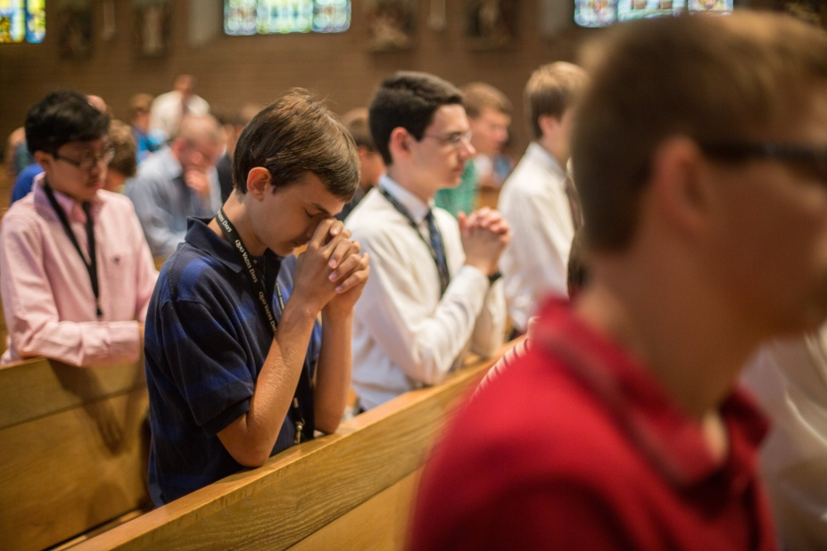
e-membership
BUT WE ALSO WANT TO RECRUIT
GOOD CATHOLICS
DEDICATED CATHOLICS
YOUNG CATHOLICS

Slide 3
e-membership
SO HOW DO WE
ACCOMPLISH
ALL THESE GOALS?

Slide 4
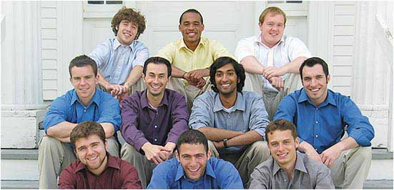
HOW DO WE ATTRACT
YOUNG GOOD CATHOLIC MEN?
e-membership

Slide 5
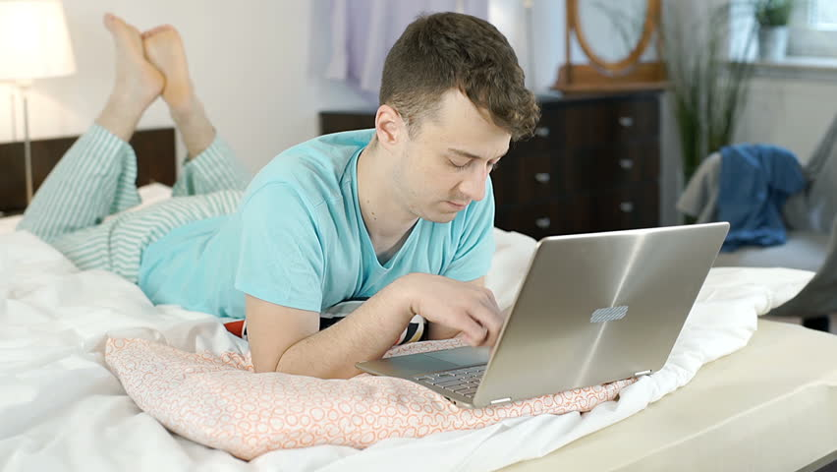
e-membership
E-MEMBERSHIP
e-membership

Slide 6
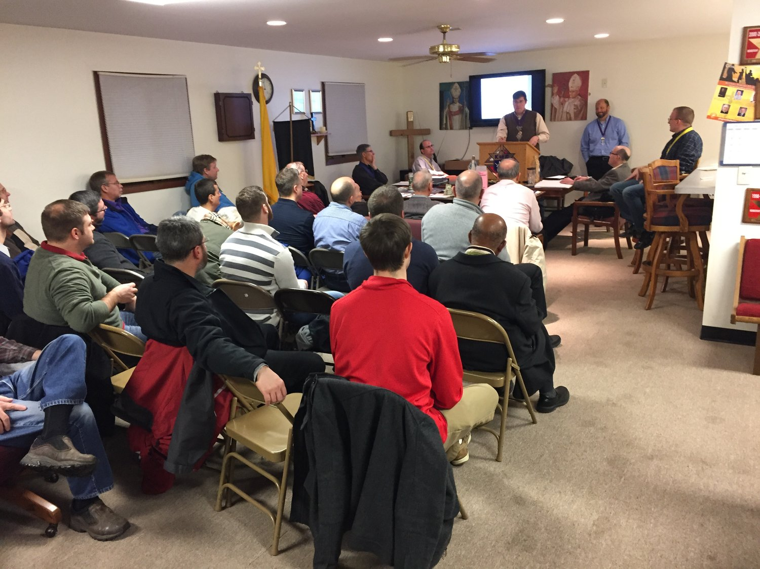
e-membership
BUT:
›YOUNG MEN TODAY DO NOT WANT TO SIT IN BORING MEETINGS
›YOUNG MEN TODAY DO NOT WANT TO WRITE CHEQUES FOR DUES
›YOUNG MEN TODAY RARELY CARRY CASH
›YOUNG MEN TODAY ARE LEERY ABOUT JOINING A COUNCIL
›YOUNG MEN TODAY BELIEVE THAT THEY DO NOT HAVE SPARE TIME

Slide 7
e-membership
HOWEVER:
›YOUNG MEN TODAY WANT TO MAKE A DIFFERENCE
›YOUNG MEN TODAY WANT TO BE CHARITABLE
›YOUNG MEN TODAY WANT LIFE INSURANCE
›YOUNG MEN TODAY WANT A RETIREMENT INCOME
›YOUNG MEN TODAY WANT TO SUPPORT THEIR PARISH

Slide 8
e-membership
SO HOW DO THEY ACCOMPLISH
THESE “WANTS” AND, “NOT WANTS”

Slide 9
e-membership
E-MEMBERSHIP
http://www.ontahttp://www.ontariokofc.ca/JOIN-US

